Slide 1
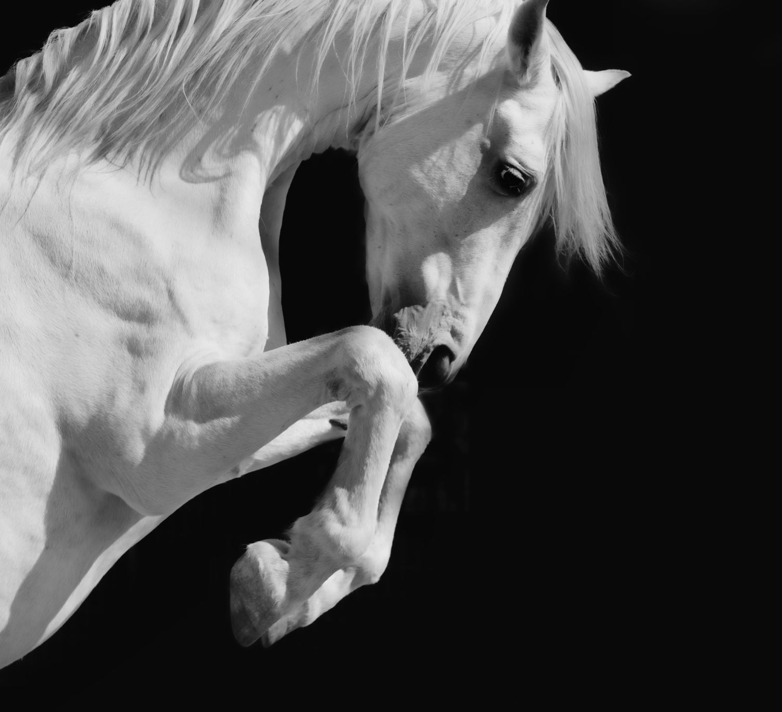
AlphaGo
創新AI碩一
111C71008
何哲平

Slide 2
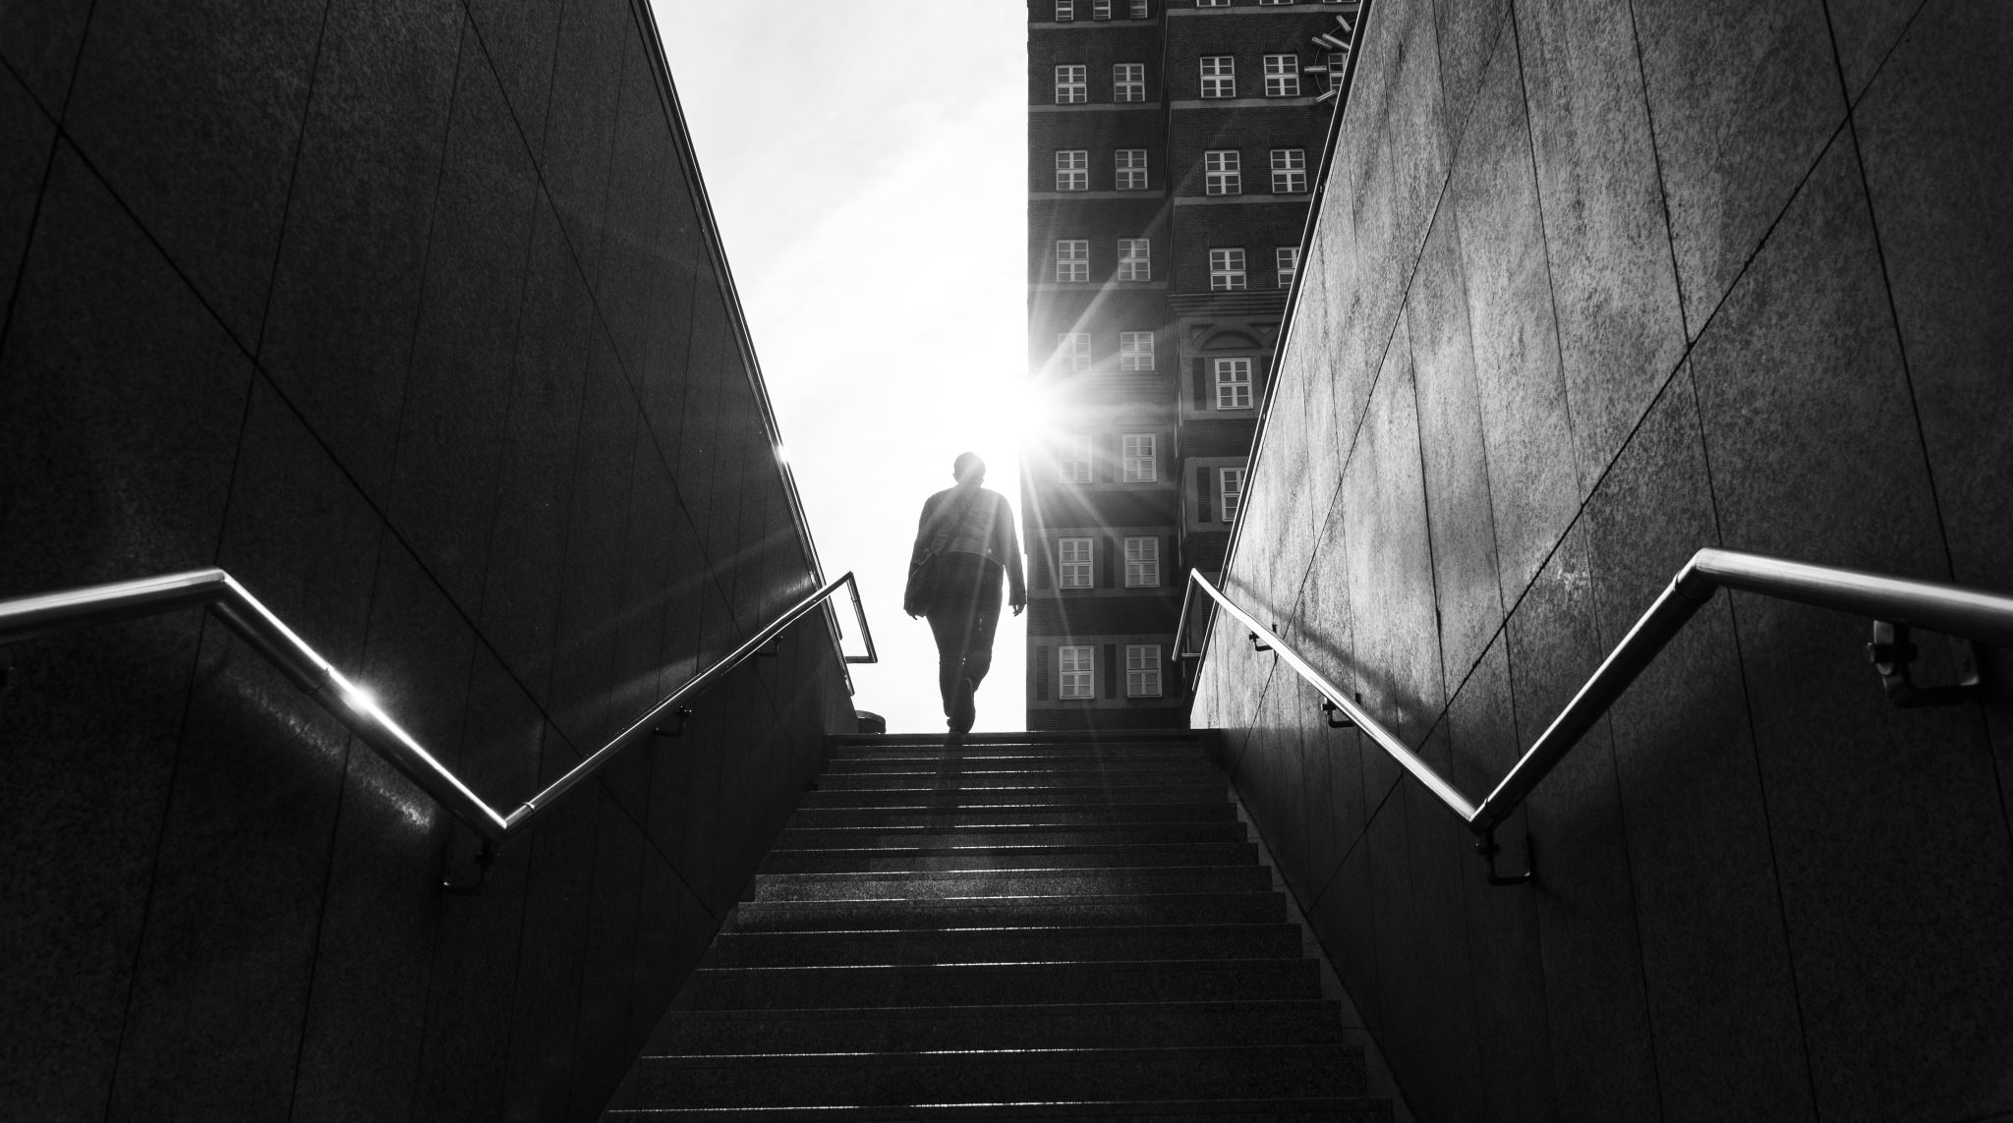
What is AlphaGo

Slide 3
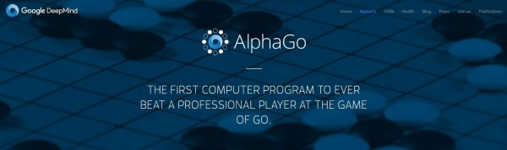
What is AlphaGo？
AlphaGo → Artificial Intelligence, Excellent at Go Chess.
Competition Record:
Year：2015 Competitor：Fan Hui, European Go Champion Record ： 5:0, AlphaGO Win → Before, No computer beaten human champion.
Year： 2016 Competitor：Lee Se-Dol, Korean Go player, 9 dan rank. Record ：4:1, AlphaGO Win → AI’s Milestone.

Slide 4

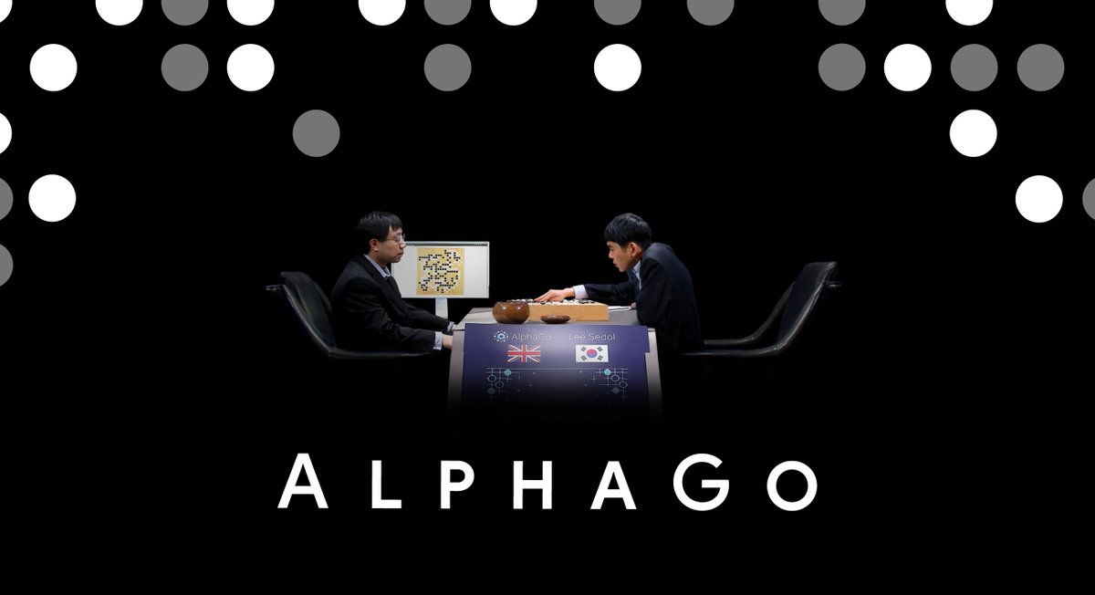
Official Trailer: AlphaGo
Notes:
《AlphaGo世紀對決》預告片
https://www.youtube.com/watch?v=KeWOIbxET94&t=3s

Slide 5
Methodology

Slide 6
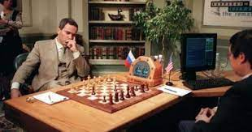
Any Other Chess AI Before AlphaGo?
Deep Blue
Year: 1996
Achievement: Beated Russian grandmaster, Kasparov. First Time World Champion Lost.
Methodology: Search Tree
MIN-MAX
Alpha–beta pruning
Notes:
超級電腦「深藍」（Deep Blue）成為第一個在標準比賽時限內擊敗西洋棋世界冠軍（卡斯巴羅夫Garry Kasparov）的電腦。
深藍仍然是專注於國際象棋的、以暴力窮舉為基礎的特定用途人工智能。
深藍算法的核心是基於暴力窮舉：生成所有可能的走法，然後執行盡可能深的搜索，並不斷對局面進行評估，嘗試找出最佳走法。

Slide 7
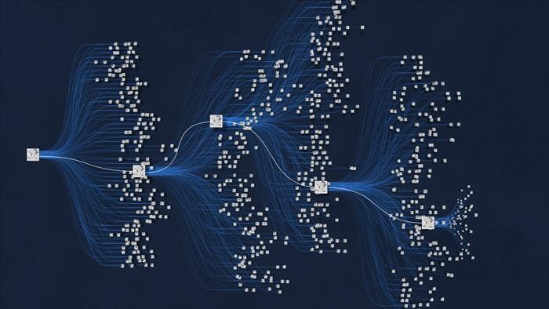
However
Aspect of Go
Grid: 19*19
The Number of possible configurations of the board More than the number of atoms in the universe.
Impossible to use Brute Force.
Neither MIN-MAX Nor Alpha–Beta Pruning.

